Slide 1
Chapter 11: Strings and Characters
The String Class
String Constructors
String Input and Output
String Class: Instance Methods
The Character Class
Conversion Methods
The StringBuffer Class
The StringTokenizer Class
The Scanner Class
Command Line Arguments
Case Studies

Slide 2


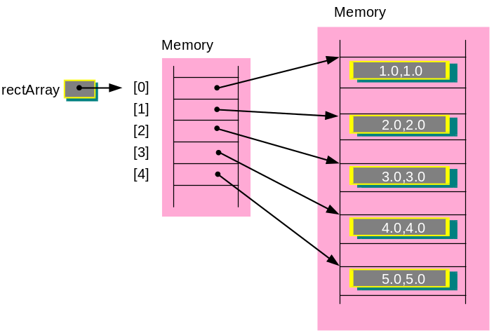

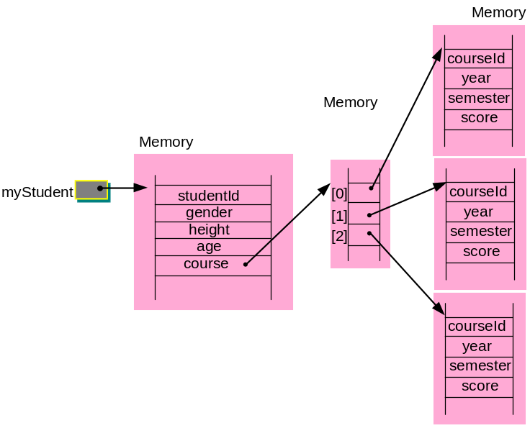
Review Ch 10: Classes and Objects
Objects and Classes
Class Definition
Message Sending
Copying Objects
The Keyword this
Passing Objects to
Methods
Accessors and Mutators
The Keyword static
Encapsulation & Information Hiding
Designing Programs with Classes
Array of Objects
Object Composition
Case Study
Instantiation
johnObject
name: John Hui
gender: M
age: 45
height: 1.78
Class name
Person
Data
- name: String
maylorObject
- gender: char
- age: int
Instantiation
name: Bill Gates
- height: double
gender: M
Methods
+ eat(): void
age: 55
+ walk(): void
height: 1.8
+ sleep(): void
+ talk(): void
edmundObject
Instantiation
name: Barack Obama
gender: M
age: 48
height: 1.8

Slide 3
Chapter 11: Strings and Characters
The String Class
String Constructors
String Input and Output
String Class: Instance Methods
The Character Class
Conversion Methods
The StringBuffer Class
The StringTokenizer Class
The Scanner Class
Command Line Arguments
Case Studies

Slide 4
The String Class
Java.lang.String is a class representing strings.
A string or string constant is a series of characters in double quotes, e.g. “Java Programming”.
In Java, strings are always created as objects.
Syntax to declare a string:
String Variable_Name ;
Since it is an object, memory will only be allocated when
Variable_Name = new String( String_Value );
Combined into one:
String Variable_Name = new String( String_Value ) ;
or
String Variable_Name = String_Value ;

Slide 5
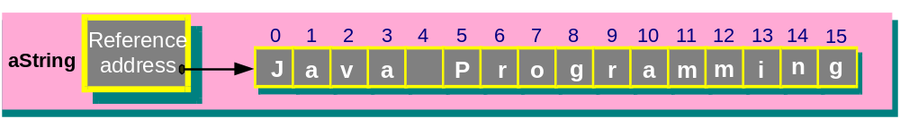
Examples
String aString = new String( “Java Programming” ); OR
String aString = “Java Programming” ;
The variable aString contains reference address of the string object
The length of the string is also stored in the string object’s storage.
String can be used as arguments for System.out.println()
System.out.println( “Java Programming” ); OR
System.out.println( aString );

Slide 6
Chapter 11: Strings and Characters
The String Class
String Constructors
String Input and Output
String Class: Instance Methods
The Character Class
Conversion Methods
The StringBuffer Class
The StringTokenizer Class
The Scanner Class
Command Line Arguments
Case Studies

Slide 7
String Constructors
public class StringConstructors {
public static void main( String[] args )
{
char[] charData = { 'S' , 'C' , '1' , '0' , '2' };
byte[] byteData = { (byte)'S' , (byte)'t' , (byte)'r' ,
(byte)'i' , (byte)'n' , (byte)'g' };
StringBuffer strBuffer =
new StringBuffer( "Introduction to Programming" );
String str1 = new String();
String str2 = new String( "Java Programming" );
String str3 = new String( charData );
String str4 = new String( charData , 2 , 3 );
String str5 = new String( byteData );
String str6 = new String( byteData , 2 , 4 );
String str7 = new String( strBuffer );
}
}
position
length

Slide 8
Program Output
str1 =
str2 = Java Programming
str3 = SC102
str4 = 102
str5 = String
str6 = ring
str7 = Introduction to Programming

Slide 9
Chapter 11: Strings and Characters
The String Class
String Constructors
String Input and Output
String Class: Instance Methods
The Character Class
Conversion Methods
The StringBuffer Class
The StringTokenizer Class
The Scanner Class
Command Line Arguments
Case Studies

Slide 10
String Input and Output
  String Input Methods (from keyboard):
  (1) System.in.read()
  – Reads a character (in integer format) at a time
  from the keyboard.
  (2) Scanner class
  – Using methods next(), nextLine(), etc.
  String Output Methods (to screen):
  (1) System.out.println()
  – Writes a string to the screen with carriage return.
  (2) System.out.print()
  – Writes a string to the screen.

Slide 11
Chapter 11: Strings and Characters
The String Class
String Constructors
String Input and Output
String Class: Instance Methods
The Character Class
Conversion Methods
The StringBuffer Class
The StringTokenizer Class
The Scanner Class
Command Line Arguments
Case Studies

Slide 12
Class String: Instance Methods
Method | Description
length() | Returns the length of the string.
charAt() | Returns the character at the specified index.
equals() | Compares two strings for equality.
equalsIgnoreCase() | Compares two strings for equality, ignoring whether characters are in uppercase or lowercase.
compareTo() | Compares two strings.
compareToIgnoreCase() | Compares two strings, ignoring whether characters are in uppercase or lowercase.
indexOf() | Returns the position of the first occurrence of a specified input character or substring.
lastIndexOf() | Returns the position of the last occurrence of a specified input character or substring.
substring() | Generates and returns a new string that is a substring of an original input string. The substring starts from a specified position, and ends with a specified position or towards the end of the string.

Slide 13
Method | Description
concat() | Concatenates another string to the end of a string.
getChars() | Copies characters from a string into a character array.
toUpperCase() | Generates a new string (given an input string) with all characters in uppercase.
toLowerCase() | Generates a new string (given an input string) with all characters in lowercase.
trim() | Removes whitespace (given an input string) from the beginning and end of the string.
replace() | Generates a new string with all occurrences of an old character replaced with a new character.
hashCode() | Generates an integer number from the string.
startsWith() | Tests whether a string starts with a specified set of characters.
endsWith() | Tests whether a string ends with a specified set of characters.
http://java.sun.com/j2se/1.5.0/docs/api/java/lang/String.html

Slide 14
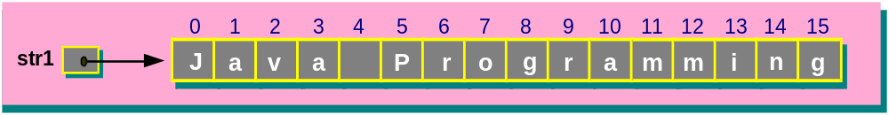
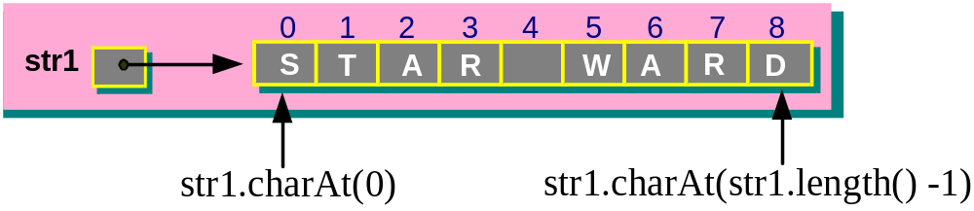
Method – length
  Determine the number of characters in a string
  For arrays, length is an instance variable, but for String, length is a method!!!
  String str1 = “Java Programming”;
  str1.length() = 16
Method – charAt
Retrieve character at specific location in String

Slide 15
public class UsingCharAt {
public static void main( String[] args ) {
String str1 = "STAR WARD" ;
int vowels = 0 ;
System.out.println( "The string is: " + str1 );
System.out.print( "The reverse string is: " );
for ( int i = str1.length()–1 ; i>=0 ; i-- ) {
System.out.print( str1.charAt(i) );
switch ( str1.charAt(i) ) {
case 'a': case 'A': case 'e': case 'E':
case 'i': case 'I': case 'o': case 'O':
case 'u': case 'U':
vowels++; }
}
System.out.println( "The string has "
+ vowels + " vowels" );
}
}
Program Output
The string is: STAR WARD
The reverse string is: DRAW RATS
The string has 2 vowels

Slide 16
Methods – Comparisons
  equals() , equalsIgnoreCase()
  compareTo() , compareToIgnoreCase()
  Compared according to lexicographic order based on Java’s Unicode character set in the following order:
  space < digits (0-9) < letters (A-Z, a-z)
  - Examples:
  " " < "$" < "1" < "9" < "A" < "Ape" < "Apeman" < "Z"
  < "Zebra" < "a" < "an" < "z" < "zero"

Slide 17
equals() string1.equals(string2)
Expression | Return value
"ABC".equals("XYZ") | false
"ABC".equals("abc") | false
"ABC".equals("ABC") | true
"ABC".equals("ABCD") | false
compareTo() string1.compareTo(string2)
Return value | Description
0 | if the two strings are equal
> 0 | if string1 is lexicographically greater than string2
< 0 | if string1 is lexicographically less than string2

Slide 18
compareTo() string1.compareTo(string2)
Expression | Value
"ABC".compareTo( "XYZ" ) | < 0
"ABC".compareTo( "abc" ) | < 0
"ABC".compareTo( "ABC" ) | 0
"123".compareTo( "abc" ) | < 0
"abcd".compareTo( "abc" ) | > 0
"abc".compareTo( "abcd" ) | < 0

Slide 19
Example: String Comparison
String str1 = “hello” ;
String str2 = “Hello” ;
String str3 = “HELLO” ;
-> str1.equals( str2 ) is false
-> str1.compareTo( str2 ) is 32
-> str2.compareTo( str1 ) is -32
-> str1.compareTo( str3 ) is 32
-> str2.compareTo( str3 ) is 32
-> str1.equalsIgnoreCase( str2 ) is true
-> str1.compareToIgnoreCase( str2 ) is 0
-> str1.compareToIgnoreCase( str3 ) is 0
-> str2.compareToIgnoreCase( str3 ) is 0

Slide 20
Methods – indexOf() and lastIndexOf()
- Search and return the index position of a given character or a given substring within an input string.
  indexOf() – locates the first occurrence
  lastIndexOf() – locates the last occurrence
  int indexOf( int ch )
  int indexOf( int ch , int startingIndex )
  int indexOf( String str )
  int indexOf( String str , int startingIndex )
  int lastIndexOf( int ch )
  int lastIndexOf( int ch , int startingIndex )
  int lastIndexOf( String str )
  int lastIndexOf( String str , int startingIndex )

Slide 21
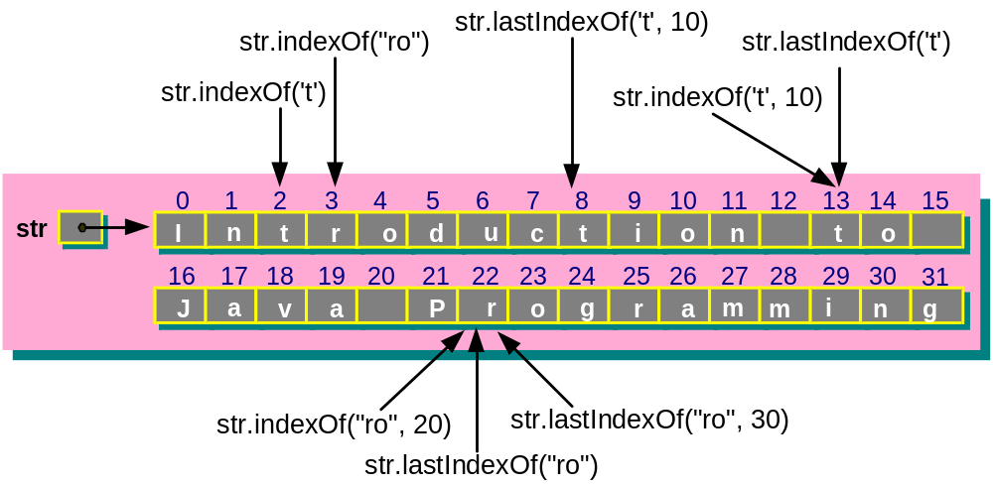
Example
String str = “Introduction to Java Programming” ;
str.indexOf( ‘t’ ) location = 2
str.indexOf( ‘t’ , 10 ) location = 13
str.indexOf( “ro” ) location = 3
str.indexOf( “ro” , 20 ) location = 22
str.lastIndexOf( ‘t’ ) location = 13
str.lastIndexOf( ‘t’ , 10 ) location = 8
str.lastIndexOf( “ro” ) location = 22
str.lastIndexOf( “ro” , 30 ) location = 22

Slide 22
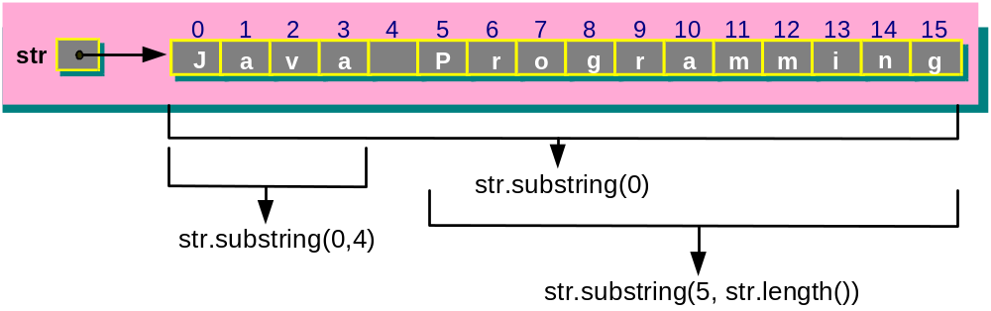
Methods - Extracting Substrings from Strings
- Extract a substring from a string.
  int substring( int startIndex )
  int substring( int startIndex , int endIndex )
Example
String str = “Java Programming” ;
str.substring( 0 ) = “Java Programming”
str.substring( 0 , 4 ) = “Java”
str.substring( 5 , str.length() ) = “Programming”

Slide 23
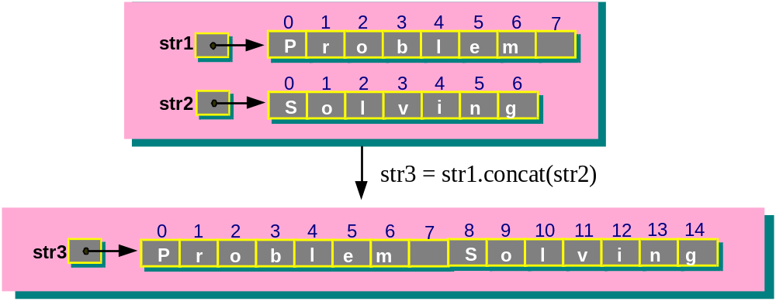
Methods – Concatenating Strings
- Concatenates two strings to form a new string.
  String concat(String aString)
Example
String str1 = “Problem ” ;
String str2 = “Solving” ;
String str3 = str1.concat( str2 );
OR String str3 = str1 + str2 ;
OR String str3 = “Problem ” + “Solving” ;
// then, str3 = “Problem Solving”
*String in Java is immutable
new string

Slide 24
Methods – Replacement of Strings
  String toLowerCase()
  - String str2 = str1.toLowerCase();
  String toUpperCase()
  - String str2 = str1.toUpperCase();
  - returns a new string formed by
  converting the characters to upper (lower) case
  String trim()
  - String str2 = str1.trim();
  - returns a new string str2 formed by
  removing whitespace from the beginning and
  end of string str1
  String replace( char oldChar , char newChar )
  - String str2 = str1.replace( oldChar , newChar );
  - returns a new string formed by replacing all occurrences of an old character with a new character
*String in Java is immutable

Slide 25
Chapter 11: Strings and Characters
The String Class
String Constructors
String Input and Output
String Class: Instance Methods
The Character Class
Conversion Methods
The StringBuffer Class
The StringTokenizer Class
The Scanner Class
Command Line Arguments
Case Studies

Slide 26
Character Class Methods
java.lang.Character is a class that represents char as objects
Class Methods for testing characters:
Method name | Returns a true if Argument is
boolean isDigit (char ch) | a digit, i.e. '0' - '9'.
boolean isLetter (char ch) | a letter, i.e. 'A' - 'Z', 'a' - 'z'.
boolean isSpaceChar (char ch) | a whitespace character, i.e. space, newline, formfeed, carriage return.
boolean isWhiteSpace (char ch) | a Java-defined whitespace character.
boolean isLowerCase (char ch) | a lowercase character, i.e. 'a' - 'z'
boolean isUpperCase (char ch) | an uppercase character, i.e. 'A' - 'Z'
Methods for converting characters:
  toLowerCase() and toUpperCase()

Slide 27
public class ConvertChar {
public static void main( String[] args ) {
int i ;
char nextChar ;
String str = "Introduction to Java Programming";
System.out.println( "The string is: " + str );
System.out.print( "The new string is: " );
for ( i = 0 ; i < str.length() ; i++ )
{
nextChar = str.charAt( i ) ;
if ( Character.isUpperCase( nextChar ) )
nextChar = Character.toLowerCase( nextChar );
else
if ( Character.isLowerCase( nextChar ) )
nextChar = Character.toUpperCase( nextChar );
System.out.print( nextChar );
}
System.out.println();
}
}
Program Output
The string is: Introduction to Java Programming
The new string is: iNTRODUCTION TO jAVA pROGRAMMING
http://java.sun.com/j2se/1.5.0/docs/api/java/lang/Character.html

Slide 28
Chapter 11: Strings and Characters
The String Class
String Constructors
String Input and Output
String Class: Instance Methods
The Character Class
Conversion Methods
The StringBuffer Class
The StringTokenizer Class
The Scanner Class
Command Line Arguments
Case Studies

Slide 29
Conversion Methods
#1: Numbers to Strings Conversion
- Three ways to convert a number into a string:
String str = “” + num ;
(2) Integer, Long, Float and Double are Wrapper classes that represent numbers as objects. They provide static methods:
String str = Integer.toString( i ); // where int i ;
String str = Double.toString( d ); // where double d ;
(3) Using the String class method:
String valueOf(Type Value)
Examples:
String str1 = new String( String.valueOf( 123 ) );
String str2 = new String( String.valueOf( 1233.56 ) );
String str3 = new String( String.valueOf( 'A‘ ) );
String str4 = new String( String.valueOf( true ) );

Slide 30
Conversion Methods
#2: Strings to Numbers Conversion
Integer, Long, Float and Double are wrapper classes that
represent numbers as objects.
They provide useful static methods for conversions
int parseInt( String str )
long parseLong( String str )
float parseFloat( String str )
double parseDouble( String str )
Examples:
String str1 = new String( "123" );
int intValue = Integer.parseInt(str1);
String str2 = new String( "123456" );
long longValue = Long.parseLong(str2);
String str3 = new String( "12.34" );
float floatValue = Float.parseFloat(str3);
String str4 = new String( "1234.56" );
double doubleValue = Double.parseDouble(str4);

Slide 31
public class ConversionMethod {
public static void main(String[] args) {
String str1 = new String( String.valueOf( 123 ) );
String str2 = new String( String.valueOf( 1233.56 ) );
String str3 = new String( String.valueOf( 'A' ) );
String str4 = new String( String.valueOf( true ) );
System.out.println( str1 );
System.out.println( "[" + str2 + "]" );
System.out.println( "[" + str3 + "]" );
System.out.println( "[" + str4 + "]" );
}
}
Program Output
123
[1233.56]
[A]
[true]

Slide 32
Chapter 11: Strings and Characters
The String Class
String Constructors
String Input and Output
String Class: Instance Methods
The Character Class
Conversion Methods
The StringBuffer Class
The StringTokenizer Class
The Scanner Class
Command Line Arguments
Case Studies

Slide 33
The StringBuffer Class
String Class – provides many methods for processing strings, the string cannot be changed once it is created.
StringBuffer Class – provides methods for creating dynamic string information, and strings can be modified and extended.
These are the key difference between them.

Slide 34
Instance Methods in StringBuffer Class
Method | Description
append() | Appends values of various data type (e.g. boolean, char, int, float, double, etc.) to the end of a StringBuffer.
insert() | Inserts values of various data type (e.g. boolean, char, int, float, double, etc.) to any position in a StringBuffer.
delete() | Removes character(s) at any position in a StringBuffer.
capacity() | Returns the number of characters that can be stored in a StringBuffer.
ensureCapacity() | Ensures a StringBuffer has a minimum capacity.
length() | Returns the number of characters in a StringBuffer.
setLength() | Increases or decreases the maximum length of a StringBuffer.
charAt() | Returns the character at the specified index (position).

Slide 35
Instance Methods in StringBuffer Class
Method | Description
setCharAt() | Sets the character at the specified position in the StringBuffer to the character argument.
getChars() | Copies character(s) from a source string in the StringBuffer into a character array.
reverse() | Reverses the contents of a StringBuffer.
replace() | Replaces the characters starting at the specified start position and ending at one position less than the specified end position in the StringBuffer, with the characters in the string argument. The number of characters replaced need not be the same as that in the string argument.
substring() | Generates a new string that is a substring of the original string in the StringBuffer. The substring starts from a specified position, and ends with a specified position or towards the end of the string in the StringBuffer.
toString() | Converts a StringBuffer into a string.

Slide 36
StringBuffer Constructors
Constructor | Description
StringBuffer() | Creates a StringBuffer with no character and an initial capacity of 16 characters.
StringBuffer(int length) | Creates a StringBuffer with no character and an initial capacity of length.
StringBuffer( String aString ) | Creates a StringBuffer with the same characters as aString and an additional capacity of 16 characters.

Slide 37
StringBuffer Constructors
public class StringBufferConstructors
{
public static void main(String[] args)
{
StringBuffer strBuf1 = new StringBuffer();
StringBuffer strBuf2 = new StringBuffer( 10 );
StringBuffer strBuf3 =
new StringBuffer( "Java Program " );
System.out.println( "strBuf1 = ["
+ strBuf1.toString() + "]" );
System.out.println( "strBuf2 = ["
+ strBuf2.toString() + "]" );
System.out.println( "strBuf3 = ["
+ strBuf3.toString() + "]" );
}
}

Slide 38
StringBuffer Constructors
Program Output
strBuf1 = []
strBuf2 = []
strBuf3 = [Java Program ]
0
1
2
3
4
5
6
7
8
9
10
11
12
13
14
15
strBuf1
0
1
2
3
4
5
6
7
8
9
strBuf2
0
1
2
3
4
5
6
7
8
9
10
11
12
13
14
15
strBuf3
J
a
v
a
P
r
o
g
r
a
m
16 characters
16
17
18
19
20
21
22
23
24
25
26
27
28
29
30
31
additional 16 character locations

Slide 39
StringBuffer Methods - Append
  Adds a data item to the end of a StringBuffer.
  StringBuffer append( Type Value )
  where parameter Value is of type Type and
  and Type can be of any primitive data types

Slide 40
public class UsingAppendMethod {
public static void main( String[] args ) {
int i = 1 ;
char[] charData = { 'S', 'C', '1', '0', '2' } ;
Object o = "Java" ;
String s = "Programming" ;
char c = '$' ;
double d = 25.999 ;
StringBuffer strBuffer = new StringBuffer(32);
strBuffer.append(i); strBuffer.append(" ");
strBuffer.append(charData); strBuffer.append("-");
strBuffer.append(o); strBuffer.append(" ");
strBuffer.append(s); strBuffer.append(" ");
strBuffer.append(c);
strBuffer.append(d);
System.out.println( "[" + strBuffer.toString() + "]" );
}
}
Program Output
[1 SC102-Java Programming $25.999]

Slide 41
The final string after the append operations in StringBuffer
strBuffer
0
1
2
3
4
5
6
7
8
9
10
11
12
13
14
15
1
S
C
1
0
2
-
J
a
v
a
P
r
o
16
17
18
19
20
21
22
23
24
25
26
27
28
29
30
31
g
r
a
m
m
i
n
g
$
2
5
.
9
9
9

Slide 42
StringBuffer Methods - Insert
  Inserts a data item to a StringBuffer at the specified index position.
  9 versions (overloaded) of the insert() method to support various data type values
  StringBuffer insert(int offset, Type Value)
  where
  offset specifies the specified index position and
  Value is Type that can be of any primitive data types.
StringBuffer Methods - Delete
  StringBuffer delete(int start, int end)
  StringBuffer deleteCharAt(int index)
  - start and end specifies the starting position and the ending at one position less than end to delete
  index specifies the index position of the character to delete

Slide 43
public class InsertDeleteMethods {
public static void main( String[] args ){
int i = 1 ;
char[] charData = { 'S','C','1','0','2' } ;
Object o = "Java" ;
String s = "Programming" ;
char c = '$' ;
double d = 25.999 ;
StringBuffer strBuffer = new StringBuffer(32);
strBuffer.insert(0,d);
strBuffer.insert(0,c); strBuffer.insert(0," ");
strBuffer.insert(0,s); strBuffer.insert(0," ");
strBuffer.insert(0,o);
strBuffer.insert(0,"-"); strBuffer.insert(0,charData); strBuffer.insert(0," "); strBuffer.insert(0,i);
System.out.println( strBuffer.toString() );
strBuffer.deleteCharAt(3);
strBuffer.delete(12,24);
System.out.println( strBuffer );
}
}
Program Output
1 SC102-Java Programming $25.999
1 S102-Java $25.999

Slide 44
StringBuffer Methods - Capacity Methods
Length()
  Returns the number of characters currently in a StringBuffer.
  int length()
Capacity()
  - Returns the number of characters that can be stored in a StringBuffer.
  int capacity()

Slide 45
StringBuffer Methods - Capacity Methods
setLength()
  Increases and decreases the maximum length of the StringBuffer.
  int setLength( int newLength )
ensureCapacity()
  - Ensures that the StringBuffer a minimum capacity.
  int ensureCapacity( int minCap )

Slide 46
public class UsingCapacity {
public static void main( String[] args ) {
StringBuffer strBuf = new
StringBuffer( "School of Computer Engineering" );
System.out.println( "StrBuf = " + strBuf.toString()
+ "\nLength = " + strBuf.length()
+ "\nCapacity = " + strBuf.capacity() );
strBuf.setLength(18);
System.out.println( "StrBuf = " + strBuf.toString()
+ "\nLength = " + strBuf.length()
+ "\nCapacity = " + strBuf.capacity() );
}
}
Program Output
StrBuf = School of Computer Engineering
Length = 30
Capacity = 46
StrBuf = School of Computer
Length = 18
Capacity = 46

Slide 47
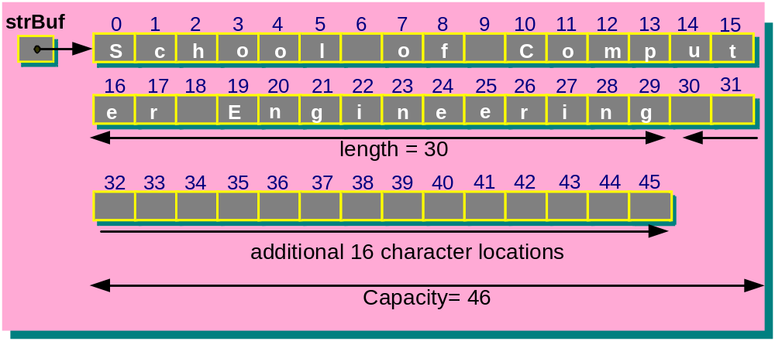
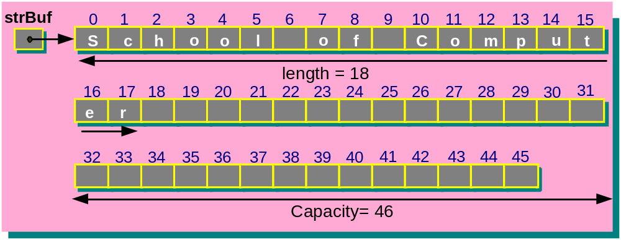
StringBuffer strBuf = new
StringBuffer( "School of Computer Engineering" );
strBuffer.setLength(18);

Slide 48
StringBuffer Methods - Character Manipulation
charAt()
  char charAt()
setCharAt()
  void setCharAt( int position , char ch )
getChars() – output to destArray
  void getChars( int startIndex ,
  int endIndex ,
  char[] destArray ,
  int destStartIndex )
reverse()
  StringBuffer reverse()

Slide 49
public class UsingCharMan {
public static void main( String[] args ) {
int i;
StringBuffer strBuf =
new StringBuffer( "School of Computer Engineering" );
System.out.println( "StrBuf = "
+ strBuf.toString() );
System.out.println( "charAt(0) = " + strBuf.charAt(0)
+ "\ncharAt(7) = " + strBuf.charAt(7) );
strBuf.setCharAt( 0 , 'G' );
strBuf.setCharAt( 7 , 'q' );
System.out.println( "After setCharAt(): strBuf = "
+ strBuf.toString() );
char[] charData = new char[ strBuf.length() ];
strBuf.getChars( 0 , strBuf.length(), charData , 0 );
System.out.print( "After getChars(): charData= " );
for ( i = 0 ; i < strBuf.length() ; i++ )
System.out.print( charData[i] );
strBuf.reverse() ;
System.out.println() ;
System.out.println( "After reverse(): strBuf = "
+ strBuf.toString() );
}
}
1
2
3
4

Slide 50
Program Output
StrBuf = School of Computer Engineering
charAt(0) = S
charAt(7) = o
After setCharAt(): strBuf = Gchool qf Computer Engineering
After getChars(): charData= Gchool qf Computer Engineering
After reverse(): strBuf = gnireenignE retupmoC fq loohcG
1
2
3
4
http://java.sun.com/j2se/1.5.0/docs/api/java/lang/StringBuffer.html

Slide 51
Chapter 11: Strings and Characters
The String Class
String Constructors
String Input and Output
String Class: Instance Methods
The Character Class
Conversion Methods
The StringBuffer Class
The StringTokenizer Class
The Scanner Class
Command Line Arguments
Case Studies

Slide 52
The StringTokenizer Class
• From package java.util
- Breaks up a string into components or tokens, e.g.,
A sentence may be broken into words
- Tokens are separated from one another by
delimiters. The default delimiters are white-space
characters (i.e. tabs, blanks, line feeds, etc.)
• Two constructors:
StringTokenizer( String str )
– Constructs a StringTokenizer object for string str
with default delimiters (i.e. white-spaces).
StringTokenizer( String str , String delim )
– You can specify delimiters delim
1
2
http://java.sun.com/j2se/1.5.0/docs/api/java/util/StringTokenizer.html

Slide 53
StringTokenizer Methods
hasMoreTokens()
  boolean hasMoreTokens()
- Returns true if there is token remaining in the string.
nextTokens()
  String nextToken()
  Returns the next token in the string.
  String nextToken( String delim )
  - Reset the delimiter and return the next token in the string.
countTokens()
  int countTokens()
  - Returns the number of tokens remaining in the StringTokenizer.

Slide 54
import java.util.StringTokenizer ;
public class StringTokenizerApp {
public static void main( String[] args )
{
StringTokenizer str1 = new StringTokenizer(
"This is SC102 course on Java programming." );
System.out.println( "countTokens() = "
+ str1.countTokens() );
while ( str1.hasMoreTokens() )
System.out.println( str1.nextToken() );
StringTokenizer str2 = new StringTokenizer(
"http://www.ntu.edu.sg/sce/asschui.html", ":/" );
System.out.println( "countTokens() = "
+ str2.countTokens() );
while ( str2.hasMoreTokens() )
System.out.println( str2.nextToken() );
}
}

Slide 55
Program Output
countTokens() = 7
This
is
SC102
course
on
Java
programming.
countTokens() = 4
http
www.ntu.edu.sg
sce
asschui.html

Slide 56
import java.util.Scanner;
import java.util.StringTokenizer;
public class StringTokenizer2 {
public static void main( String[] args ) {
String inputString , aString ;
int total = 0 ;
Scanner sc = new Scanner( System.in );
System.out.print( "Enter your number strings: " );
inputString = sc.nextLine();
StringTokenizer str = new
StringTokenizer( inputString );
System.out.println( "countTokens() = "
+ str.countTokens() );
while ( str.hasMoreTokens() ) {
aString = str.nextToken();
total += Integer.parseInt( aString );
}
System.out.println( "The total is " + total );
}
}
Using with Scanner class
Program Output
Enter your number strings: 13 45 67
countTokens() = 3
The total is 125

Slide 57
Chapter 11: Strings and Characters
The String Class
String Constructors
String Input and Output
String Class: Instance Methods
The Character Class
Conversion Methods
The StringBuffer Class
The StringTokenizer Class
The Scanner Class
Command Line Arguments
Case Studies

Slide 58
The Scanner Class
In the Scanner class, a word can be used as a delimiter.
import java.util.Scanner;
public class ScannerApp
{
public static void main(String[] args)
{
Scanner str1 = new
Scanner( "This is SC102 course on Java programming." );
str1.useDelimiter( "course" );
while ( str1.hasNext() )
System.out.println( "[" + str1.next() + "]" );
}
}
Program Output
[This is SC102]
[ on Java programming.]
http://java.sun.com/j2se/1.5.0/docs/api/java/util/Scanner.html

Slide 59
Chapter 11: Strings and Characters
The String Class
String Constructors
String Input and Output
String Class: Instance Methods
The Character Class
Conversion Methods
The StringBuffer Class
The StringTokenizer Class
The Scanner Class
Command Line Arguments
Case Studies

Slide 60
Command Line Arguments
The command line is the string of characters we type in order to run a program.
Arguments can be given to commands as options. For example, on our Linux platform (or other Unix system):
  ls
  ls –las
  cat file1 file2 file3 …
  where -las is the argument for ls and file1 file2 file3 ... are the arguments for cat.

Slide 61
• User can also supply arguments to his program, e.g.
$java CommandLineApp argument1, argument2, ...
Arguments of main() methods receive these inputs:
… main( String[ ] args )
{
...
}
where args is the array of argument strings which stores the user-input arguments from the command line.
However, the command itself is not counted, i.e.,
args[0] stores argument1, args[1] stores argument2, etc.

Slide 62
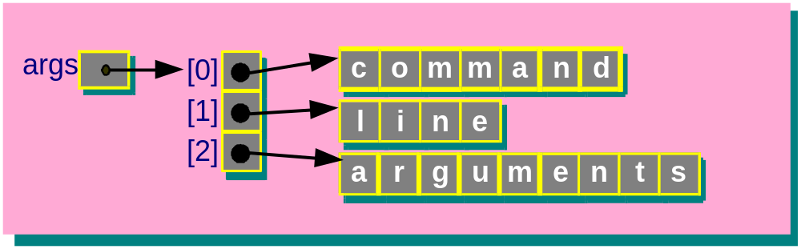
import java.util.StringTokenizer ;
public class CommandLineApp {
public static void main( String[] args ) {
int i;
System.out.println( "args.length = " + args.length );
for ( i = 0 ; i < args.length ; i++)
System.out.println( "args " + i + " = ["
+ args[i] + "]" );
System.out.println();
}
}
Program Output
$ java CommandLineApp command line arguments
args.length = 3
args 0 = command
args 1 = line
args 2 = arguments

Slide 63
Chapter 11: Strings and Characters
The String Class
String Constructors
String Input and Output
String Class: Instance Methods
The Character Class
Conversion Methods
The StringBuffer Class
The StringTokenizer Class
The Scanner Class
Command Line Arguments
Case Studies

Slide 64
Case Studies
Two case studies in the textbook:
Text Editor
– which demonstrates the use of the StringBuffer class.
(2) String Sorting
– which demonstrates the use of the String class
and array of strings manipulation.

Slide 65
Case Study: Text Editor Application
Problem Specification
Write a program to implement a text editor application.
The text editor class should contain methods for text operations including insert, replace, delete, find, reverse and case change.
In addition, write an application class to test the text editor class. In the application class, it should allow the user to specify the required text editing operation, and execute the corresponding operation.

Slide 66
Text Editor Application
Class name:
TextEditor
Data:
strBuf: An instance variable to store the string on
input sentence
Methods:
readTextString: A method to read the input string
displayTextString: A method to display the current
string in buffer
displayCommands: A method to display the command menu
insertWord: A method to insert a word or character
deleteChar: A method to delete a character
deleteWord: A method to delete a word
replaceChar: A method replace a character
replaceWord: A method replace a word
reverseData: A method to reverse the content of
the string
upperAndLowerCase: A method to display the string
content from uppercase to lowercase
or from lowercase to uppercase

Slide 67
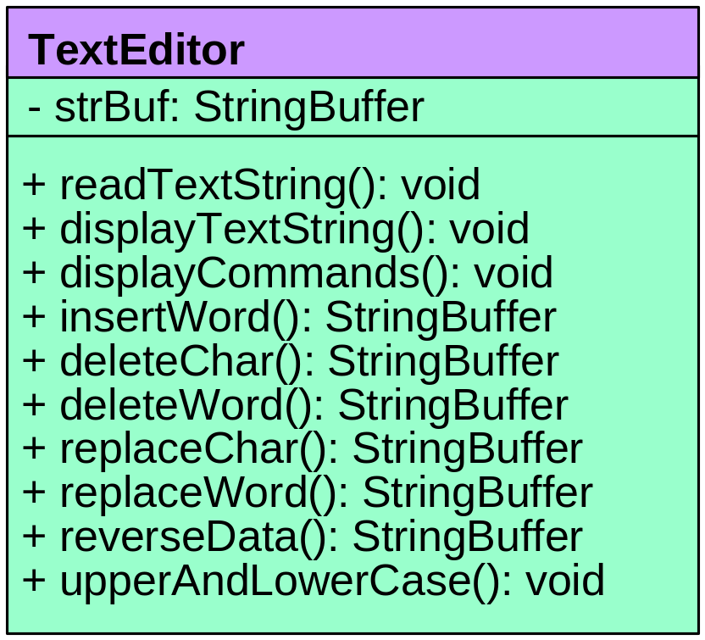
Text Editor Application
Class diagram:
Application Class name:
TextEditorApp
Method:
main: A method to start the text editor
application.
[Refer to the textbook for the implementation]

Slide 68
Testing: Program input and output
Enter a string sentence to edit:
NTU Computer Engineering
====== Text Editor ======
To DELETE a character/word
To INSERT a character/word
To REPLACE a character/word
To REVERSE the sentence
...
To QUIT
Command> INSERT
Enter the words to insert: School
At index: 3
NTU School Computer Engineering
Command> REPLACE
Enter 1 to replace character or 2 to replace word: 2
Enter the new word: Material
Enter the start and end indexes: 11 19
NTU School Material Engineering
Command> DELETE
Enter 1 to delete character or 2 to delete word: 2
Enter start and end indexes: 19 28
NTU School Materialing
Command> QUIT

Slide 69
Case Study: String Sorting Application
Problem Specification
Write a Java program to implement a string sorting application.
The SortingString class contains methods to support string sorting operations including
(1) readStrings() to read a number of strings (2) displayStrings() to display the strings
(3) sortStrings() to sort the stored strings
Write an application class to test the application.

Slide 70
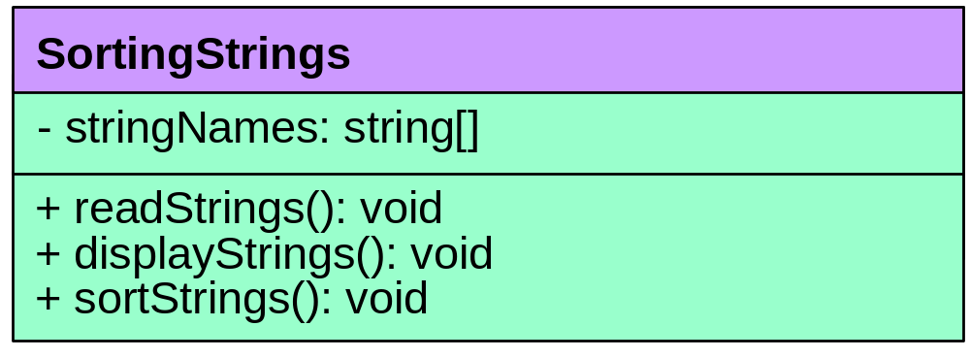
SortingStrings Application
Class name:
SortingStrings
Data:
stringNames: An instance variable to store an array
of string names.
Methods:
sortStrings: To sort the strings in the array.
displayStrings: To display the sorted strings.
readStrings: To read the strings.
Class Diagram:
Application Class name:
SortStringsApp
Method:
main: A method to start the string sorting
application.

Slide 71
[Refer to the textbook for the implementation]
Testing: Program input and output
Enter names: Kim
Enter names: Ken
Enter names: Tom
Enter names: Kathy
Enter names: Brad
Before sorting:
Kim
Ken
Tom
Kathy
Brad
After sorting:
Brad
Kathy
Ken
Kim
Tom

Slide 72
Further Reading
Read Chapter 11 on “Strings and Characters” of the textbook.
Read the case studies from the chapter.

Slide 73

Thank you !!!

